Slide 1

A new summer program in Germany and Spain exposes students to communities and businesses leading the renewable-energy revolution.

Slide 2
LED lighting installations across campus reduce energy costs and greenhouse gas emissions.

Slide 3
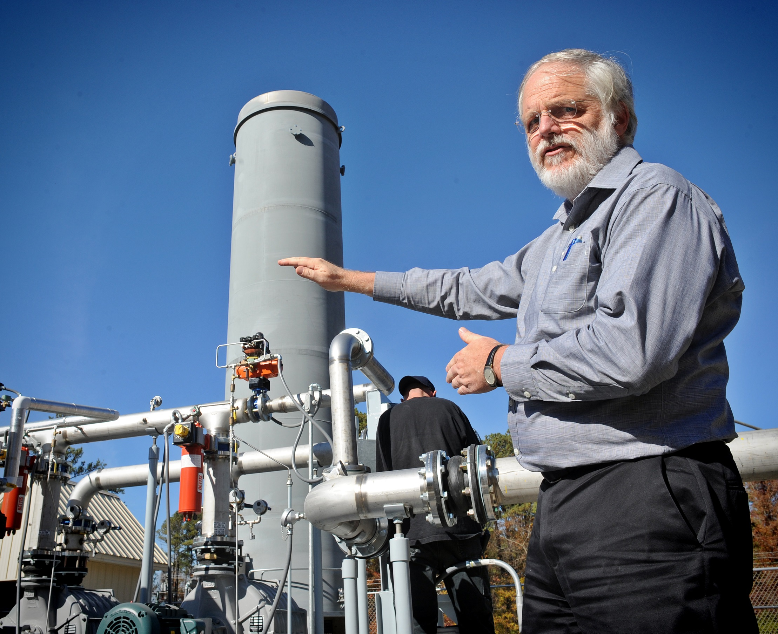
A 1,000 kilowatt generator converts gas from the Orange County landfill into electricity for the grid. This reduces methane emissions and provides a revenue stream to Orange County.

Slide 4
The LEED Gold Genome Sciences building features high-performance glazing, integrated shading devices, and active chilled beams. Rainwater and reclaimed water flush the toilets and irrigate the landscape.

Slide 5

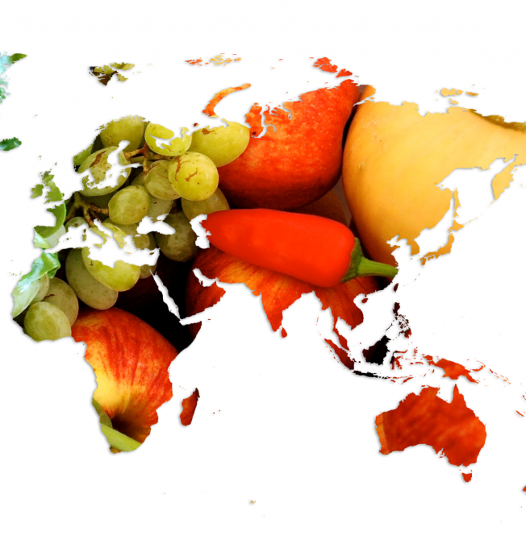
“Water in Our World” was the first pan-campus theme. Next: “Food for All”. These themes incorporate social justice concepts and encourage collaboration, course revision, research, events, and engagement.

